Slide 1
Speech calculator
--Android study
Randy

Slide 2
Outline
Android development environment
Study case introduction
Android resource

Slide 3
Android development environment
Java
xml
Android
SDK
Eclipse

Slide 4
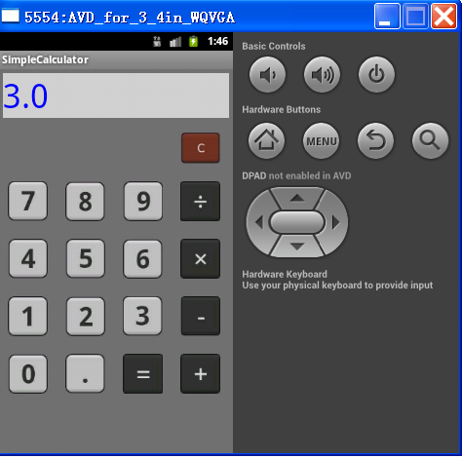
Study case introduction
Speech calculator

Slide 5
UI
Image button
+
Edit text
TableLayout
+

Slide 6
Android resource
http://developer.android.com/index.html

